Slide 1
IT2757
Server and Services Security Management
- SYS LOG

Slide 2
Outline
Log files
  What need to be logged
  Logging policies
  Finding log files
Syslog: the system event logger
  how syslog works
  its configuration file
  the software that uses syslog
  debugging syslog

Slide 3
What to be logged?
The accounting system
The kernel
Various utilities
  all produce data that need to be logged
  most of the data has a limited useful lifetime, and needs to be summarized, compressed, archived and eventually thrown away

Slide 4
Logging policies
Throw away all data immediately
Reset log files at periodic intervals
Rotate log files, keeping data for a fixed time
Compress and archive to tape or other permanent media

Slide 5
Which one to choose
Depends on :
  how much disk space you have
  how security-conscious you are
Whatever scheme you select, regular maintenance of log files should be automated using cron (chap 10, periodic process)

Slide 6
Throwing away log files
not recommend
  security problems ( accounting data and log files provide important evidence of break-ins)
  helpful for alerting you to hardware and software problems.
In general, keep one or two months
  in a real world, it may take one or two weeks for SA to realize that site has been compromised by a hacker and need to review the logs

Slide 7
Throwing away (cont.)
Most sites store each day’s log info on disk, sometimes in a compressed format
These daily files are kept for a specific period of time and then deleted
One common way to implement this policy is called “rotation”

Slide 8
Rotating log files
Keep backup files that are one day old, two days old, and so on.
  logfile, logfile.1 , logfile.2, … logfile.7
Each day rename the files to push older data toward the end of the chain
  script to archive three days files

Slide 9
#! /bin/sh
cd /var/log
mv logfile.2 logfile.3
mv logfile.1 logfile.2
mv logfile logfile.1
cat /dev/null > logfile
Some daemons keep their log files open all the time,
this script can’t be used with them. To install a new
log file, you must either signal the daemon, or kill
and restart it.

Slide 10
#! /bin/sh
cd /var/log
mv logfile.2.Z logfile.3.Z
mv logfile.1.Z logfile.2.Z
mv logfile logfile.1
cat /dev/null > logfile
kill -signal pid
compress logfile.1
signal - appropriate signal for the program
writing the log file
pid - process id

Slide 11
Archiving log files
Some sites must archive all accounting data and log files as a matter of policy, to provide data for a potential audit
Log files should be first rotate on disk, then written to tape or other permanent media

Slide 12
Finding log files
To locate log files, read the system startup scripts : /etc/rc* or /etc/init.d/*
  if logging is turned on when daemons are run
  where messages are sent
Some programs handle logging via syslog/rsyslog
  check /etc/(r)syslog.conf to find out where this data goes

Slide 13
Finding log files
Different operating systems put log files in different places:
  /var/log/*
  /var/cron/log
  /usr/adm
  /var/adm …
On linux, all the log files are in /var/log directory.

Slide 14
What is syslog
A comprehensive logging system, used to manage information generated by the kernel and system utilities.
Allow messages to be sorted by their sources and importance, and routed to a variety of destinations:
  log files, users’ terminals, or even other machines.

Slide 15
Syslog: three parts
(r)Syslogd and /etc/(r)syslog.conf
  the daemon that does the actual logging
  its configuration file
openlog, syslog, closelog
  library routines that programs use to send data to syslogd
logger
  user-level command for submitting log entries

Slide 16
syslog-aware programs
Using syslog lib. Routines
write log entries to a special file
/dev/log
/dev/klog
reads
consults
syslogd
/etc/syslog.conf
dispatches
Log
files
Users’s
terminals
Other
machines

Slide 17
Configuring syslogd
The configuration file /etc/(r)syslog.conf controls (r)syslogd’s behavior.
It is a text file with simple format, blank lines and lines beginning with ‘#’ are ignored.
  Selector <TAB> action
  eg. mail.info /var/log/maillog

Slide 18
Config file examples
# Small network or stand-alone syslog.conf file
# emergencies: tell everyone who is logged on
*.emerg *
# important messages
*.warning;daemon,auth.info /var/adm/messages
# printer errors
lpr.debug /var/adm/lpd-errs

Slide 19
# network client, typically forwards serious messages to
# a central logging machine
# emergencies: tell everyone who is logged on
*.emerg;user.none *
#important messages, forward to central logger
*.warning;lpr,local1.none @netloghost
daemon,auth.info @netloghost
# local stuff to central logger too
local0,local2,local7.debug @netloghost
# card syslogs to local1 - to boulder
local1.debug @boulder.colorado.edu
# printer errors, keep them local
lpr.debug /var/adm/lpd-errs
# sudo logs to local2 - keep a copy here
local2.info /var/adm/sudolog

Slide 20
Sample syslog output
Dec 27 02:45:00 x-wing netinfod [71]: cann’t lookup child
Dec 27 02:50:00 bruno ftpd [27876]: open of pid file
failed: not a directory
Dec 27 02:50:47 anchor vmunix: spurious VME interrupt
at processor level 5
Dec 27 02:52:17 bruno pingem[107]: moose.cs.colorado.edu
has not answered 34 times
Dec 27 02:55:33 bruno sendmail [28040] : host name/address
mismatch: 192.93.110.26 != bull.bull..fr

Slide 21
Syslog ‘s functions
Liberate programmers from the tedious mechanics of writing log files
Put SA in control of logging
  before syslog, SA had no control over what info was kept or where it was stored.
Can centralize the logging for a network system

Slide 22
Software that uses syslog
Program Facility Levels Description
named daemon err-info Name sever (DNS)
passwd auth err Password setting programs
sendmail mail debug-alert Mail transport system
rwho daemon err-notice remote who daemon
su auth crit, notice substitute UID prog.
sudo local2 notice, alert Limited su program
syslogd syslog, mark err-info internet errors,
timestamps

Slide 23
Configuration file selector
Identify
  source -- the program (‘facility’) that is sending a log message
  importance -- the messages’s severity level
  eg. mail.info /var/log/maillog
Syntax
  facility.level
  facility names and severity levels must chosen from a list of defined values

Slide 24
Configuration file
Facility names
Facility Programs that use it
kern the kernel
user User process, default if not specified
mail The mail system
daemon System daemons
auth Security and authorization related commands
lpr the BSD line printer spooling system
news The Usenet news system

Slide 25
Configuration file
Facility names
Facility Programs that use it
uucp Reserved for UUCP
cron the cron daemon
mark Timestamps generated at regular intervals
local0-7 Eight flavors of local message
syslog syslog internal messages
authpriv Private or system authorization messages
ftp the ftp daemon, ftpd
* All facilities except “mark”

Slide 26
Configuration file
Facility names
Timestamps can be used to log time at regular intervals (by default, every 20 minutes), so you can figure out that your machine crashed between 3:00 and 3:20 am, not just “sometime last night”. This can be a big help if debugging problems occur on a regular basis.

Slide 27
Configuration file severity level
Level Approximate meaning
emerg (panic) Panic situation
alert Urgent situation
crit Critical condition
err Other error conditions
warning Warning messages
notice Unusual things that may need
investigation
info Informational messages
debug For debugging

Slide 28
Configuration file selector
Can include multiple facilities separated with ‘,’ commas
  daemon,auth,mail.level action
Multiple selector can be combined with ‘;’
  daemon.level1; mail.level2 action
Selector are ‘|’ --ORed together, a message matching any selector will be subject to the action.
Can contain ‘*’ or ‘none’, meaning all or nothing.

Slide 29
Configuration file selector
Levels indicate the minimum importance that a message must have in order to be logged
  mail.warning, would match all the messages from mail system, at the minimum level of warning
Level of ‘none’ will excludes the listed facilities regardless of what other selectors on the same line may say.
  *.level1;mail.none action
    all the facilities, except mail, at the minimum level 1 will subject to action

Slide 30
Configuration file action
(Tells what to do with a message)
Action Meaning
filename Write message to a file on the
local machine
@hostname Forward message to the syslogd on
hostname
@ipaddress Forward message to the host at IP address
user1, user2,… Write message to users’ screens if they
are logged in
* Write message to all users logged in

Slide 31
Configuration file action
If a filename action used, the filename must be absolute path. The file must exist, syslogd will not create it.
  /var/log/messages
If a hostname is used, it must be resolved via a translation mechanism such as DNS or NIS
While multiple facilities and levels are allowed in a selector, multiple actions are not allowed.

Slide 32
Final words
On linux, check following files:
  /etc/rsyslog.conf : syslog configuration file
  /etc/logrotate.conf : logging policy, rotate
  /etc/logrotate.d/*
  /var/log/* : log files
try following commands to find out more...
  man logrotate
  man syslogd

Slide 33
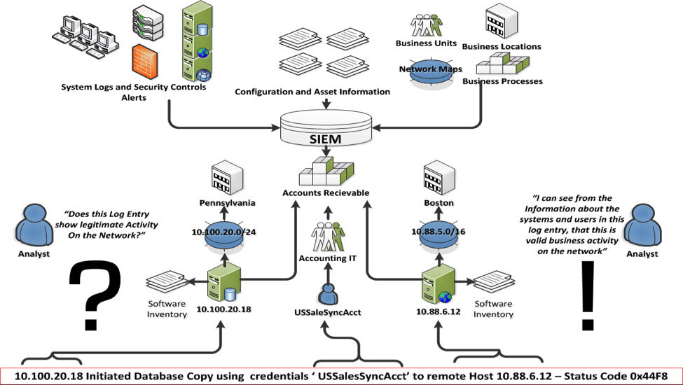
Security Information and Event Management (SIEM)
What is SIEM
  combine security information management (SIM) and security event management (SEM). They provide real-time analysis of security alerts generated by network hardware and applications.

Slide 34
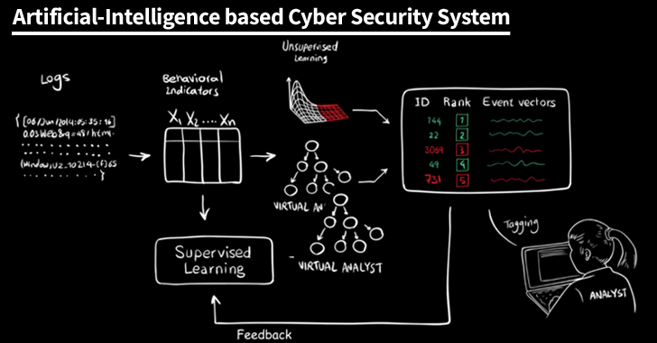
Artificial Intelligence and SIEM

Slide 35
THE END

